Slide 1

Functions in C Programming
Presented By:- Siburanjan Samal

Slide 2

Contents
What is a Function?
Advantages of Function.
How the Function works ?
Function Protoytype
Function Definitions
Function Return Types
Types of Function

Slide 3
What is a Function?
A large program in C can be divided into functional parts.
Each part may be individually coded and later combined into a single unit.
These independently coded program are called as subprograms.
In C, such subprograms are referred to as "Functions"

Slide 4
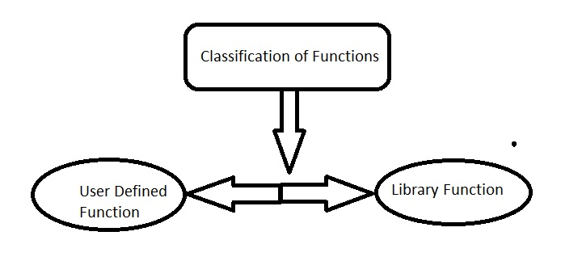
Classification of Function

Slide 5
User Defined Functions:-
Function that is coded by user on the basis of need
A C program contains atleast one user defined function which is "main()"
Library Functions:-
In-built functions that is provided by the c in the inbuilt Library(libc).
This are the predefined functions ex- printf(), scanf(), math(), etc.

Slide 6
Advantages of Function
It is much easier to write a structured program where a large program can be divided into a smaller and simpler task.
Allowing the code to be called many times.
Easier to read and update.
It is easier to debug a structured program where the error is easy to find and fix.

Slide 7
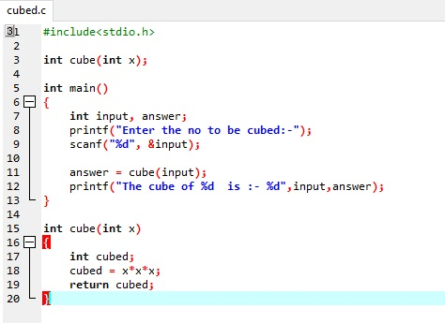
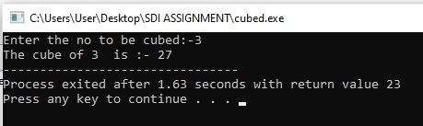
Example
* Function name is cube.
* Variable required is int
* return type is int
*The variable passed to the function is x.
*Value is be passed to the function and the function is called in main() so that the function can perform specific task. It is called Arguments.

Slide 8
How the function works
C doesn’t executes the statement in the function till the function is called.
When the function is called the program send the function information in form of arguments.
When the function is used it is referred to as Called function.
Function often uses data that is passed through function calling.
Data is passed from the calling function to the called function by specifying the variable in a list of argument.
Argument list cannot be used to send data. It just copies the data/variable/values that passes from the calling function.

Slide 9
Function Prototype
Provides the compiler with the description of the function.
It defines the function before it is called.
It is to be written at the beginning of the program.
Function prototype must have:
Return type specifying the variable type that the function will return.
Syntax:
Ret_type func_name(arg1_type name1, arg2_type name2...)

Slide 10
Function defination
It is the actual function that contains the code that has to be executed.
Should be identical to the function prototype.
Syntax:-
Return_type func_name(arg1_type name1, arg2_type name2) Function header
{
declaration;
Statement; Function Body
Return(expression);
}

Slide 11
Function return Type
Can be any of the C datatype:-
Char
Int
Float
Long.......................,etc
Example:-
int func(…) //Return a type int
char func(…) //Return a type char
long func(…) //Return a type long

Slide 12
Type of Functions
Function can be divided into 4 catogories:-
A function with no argument and no return value
A function with no argument and a return value
A function with an argument or arguments and returning no return
A function with arguments and returning a value

Slide 13
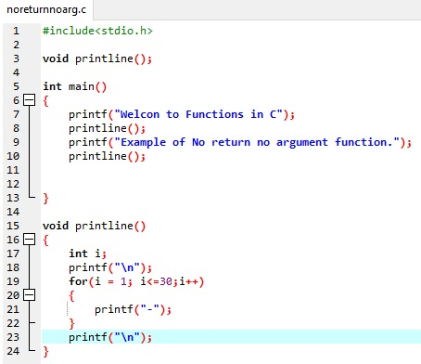
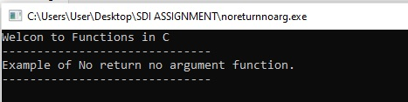
A function with no argument and no return value
Called function doesn’t have any argument and also no return.
Return type is specified as void.
There is no data transfer between calling function and called function.

Slide 14
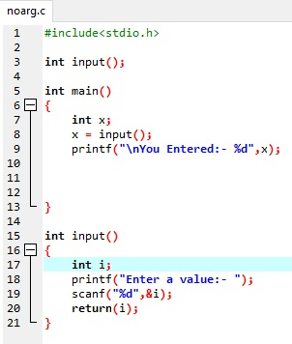

A function with no argument and a return value
Called function doesn’t take any argument but gives return.
Doesn’t get any value from the calling function.
Can give a return value.

Slide 15
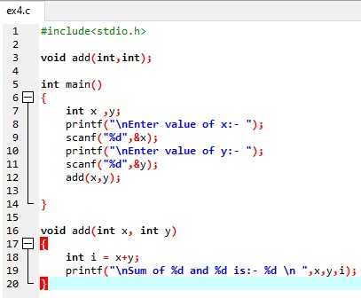
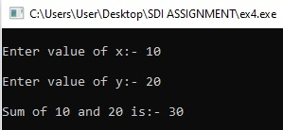
A function with an argument/arguments and no return value
Called function take an argument/arguments but gives no return.
Doesn’t give any return value to the calling function.

Slide 16
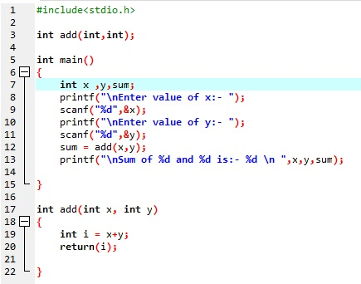
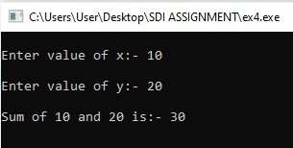
A function with an argument/arguments and a return value
Called function take an argument/arguments and also gives a return.
Does give a return value to the calling function.

